Slide 1
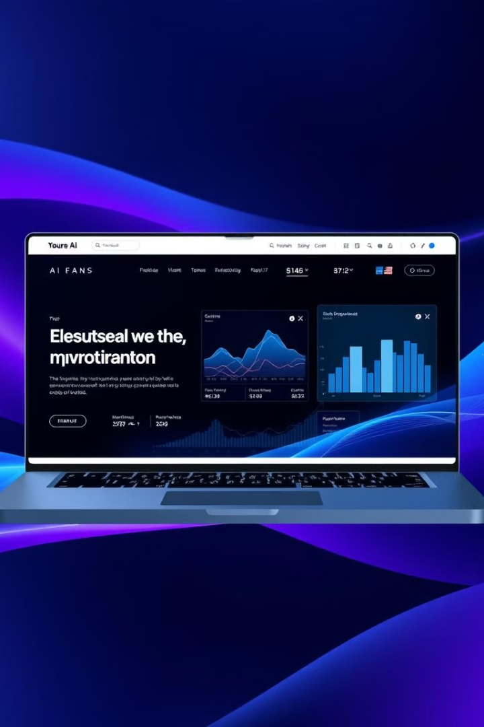
AI-Powered
E-Commerce: The Future of Smart Shopping
Presenter :
M Inshal Rabbani
M Moeen
Ismail Shah
M Rehan
M Anas

Slide 2
AI-Powered Ecommerce Website: Presentation Overview
1
Title Slide
2
Introduction
3
Home Page Overview
4
Product Pages (Dynamic)
5
Cart & Checkout System
6
Admin Dashboard
7
About Page (with Developer Information)
8
AI Chatbot Integration
9
Beyond Innovation
10
Order Summary
11
Conclusion

Slide 3



Welcome to Zen Store
Discover tranquility with our curated collection.
Step into a world of stylish comfort.
Elevate your everyday experience.
Shop Now
Fast Delivery
Easy Payment
Get your order quickly and reliably.
Seamless transactions for your convenience.
Explore our latest arrivals and step into style.
Men's Collection
Women's Collection
Sports Collection
Explore our range of styles for men.
Discover fashionable options for women.
Gear up with our premium sports selection.

Slide 4





Easy Transactions: From Cart to Completion
AI-powered cart management
Personalized payment options
Automated order tracking
Secure and streamlined checkout

Slide 5
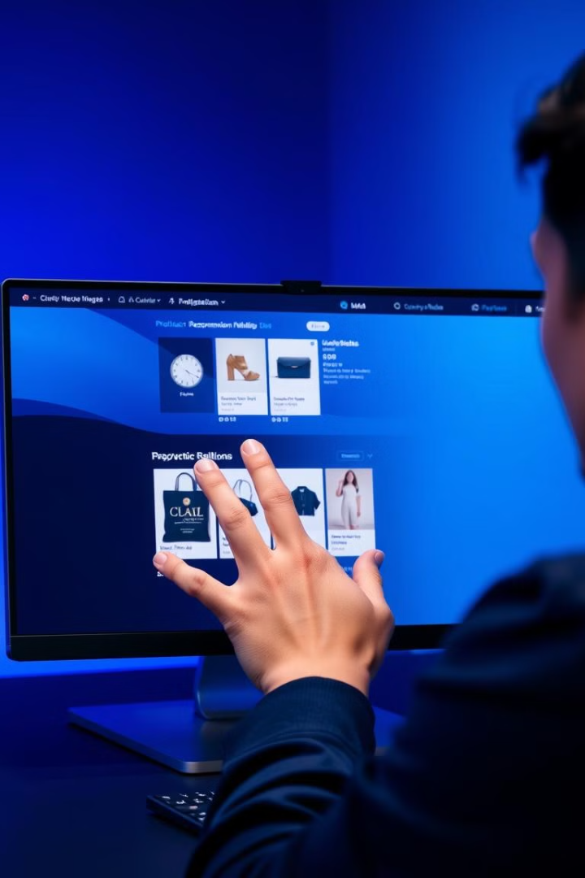
Smooth & Smart Shopping Starts Here
Smooth Search
Intelligent search engine thatunderstands natural language and provides relevant results
Intuitive Navigation
Easy-to-use interface with streamlined navigation and seamless browsing

Slide 6
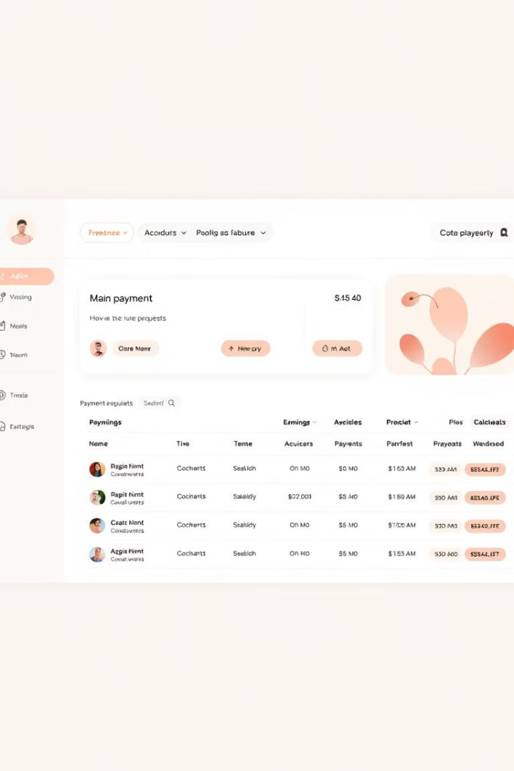
Admin Dashboard
Streamlining payment requests for efficiency. User-friendly design for easy navigation.
Accept, reject, or remove requests effortlessly.
User Name
Status
Actions
John Doe
Pending
Accept/Reject
Filters for sorting by status enable quick organization.

Slide 7
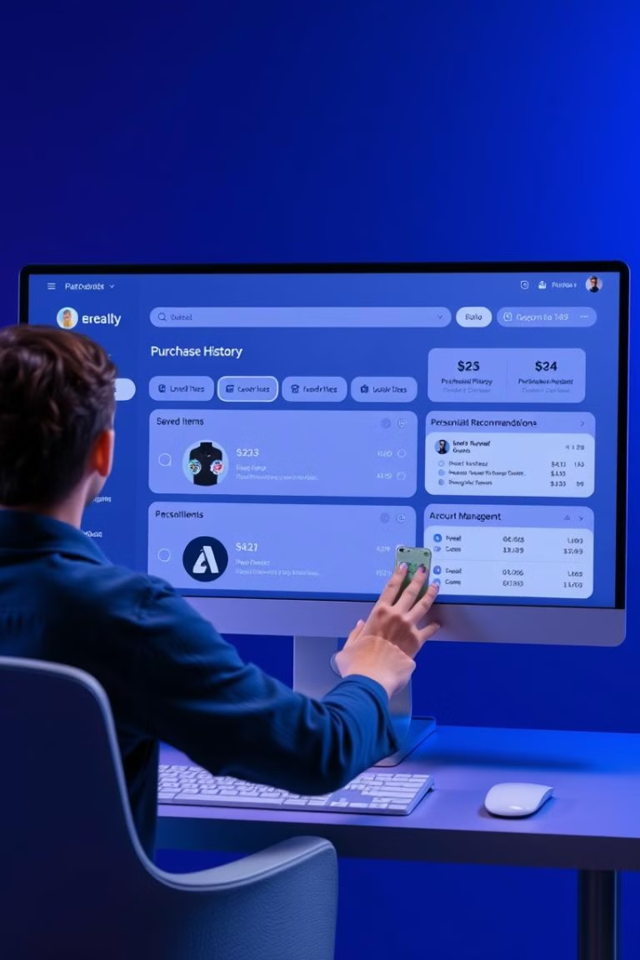



Your Personalized Shopping Hub
Purchase history
Account management
Customer support

Slide 8
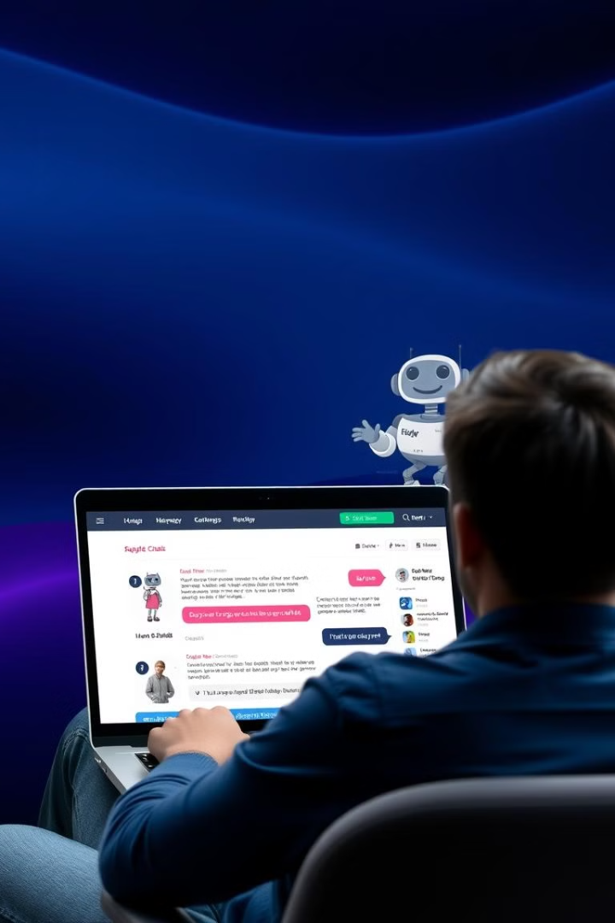
Conversational AI: Instant Assistance, Anytime
Product information
Order tracking
Customer support

Slide 9





Beyond Innovation: What’s Next in AI Shopping?
1
Virtual try-on
2
AI-powered style recommendations
3
Predictive shopping lists
4
Visual Search
5
Enhanced security

Slide 10
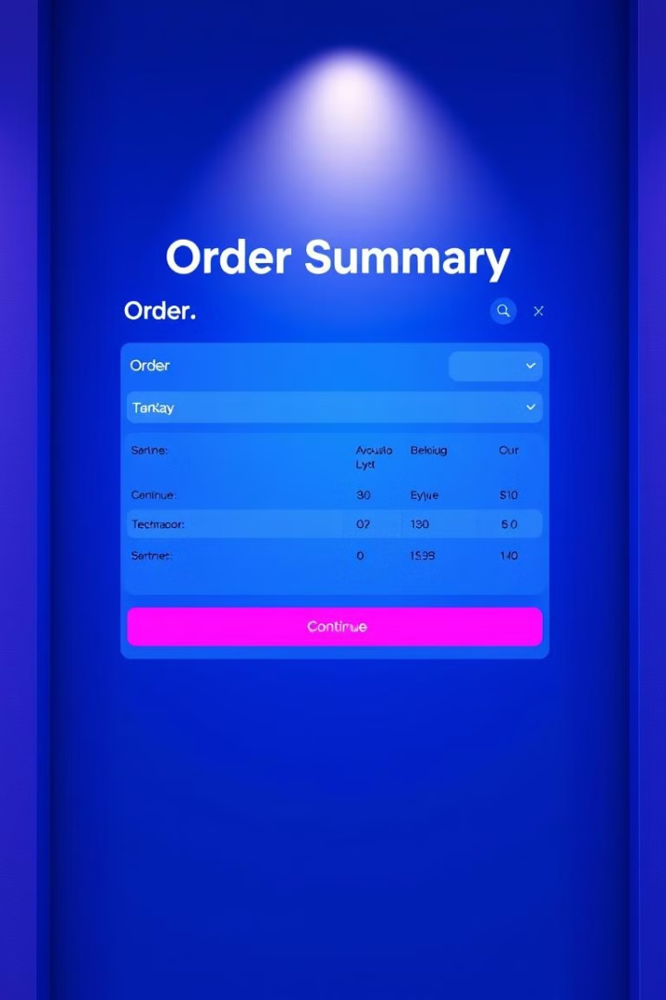
A Order Summary Page Design
Item Name
Price
Quantity
Product A
12299 PKR
2
Product B
10000 PkR
1
Product C
12988 PKR
3
This order summary provides a clear overview. It shows item names, prices, and quantities. The quantities are non-editable to finalize the transaction.
The Continue Shopping button redirects to the homepage. This allows seamless navigation. This can help increase further purchases.

Slide 11

About the Development Team
Meet the experts behind our eCommerce platform, a passionate team dedicated to crafting a seamless online shopping experience. We're a diverse group of developers, each bringing unique skills and experience to the table. Our team works tirelessly to ensure every aspect of the platform—from design and development to testing and maintenance—is top-notch.

Slide 12
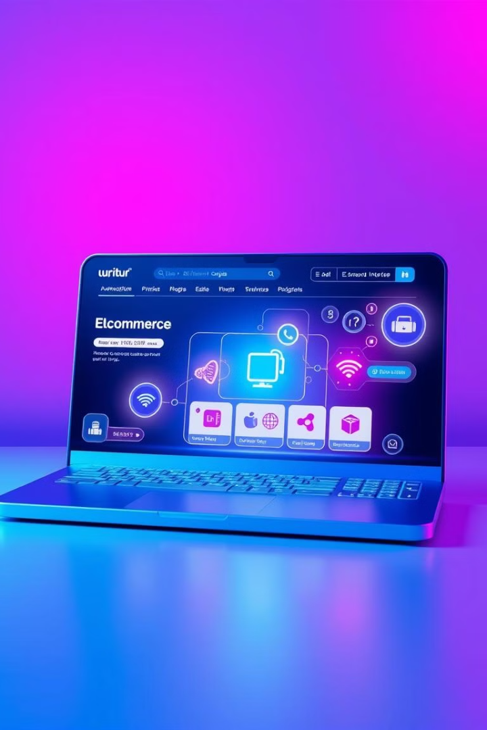
Conclusion:
Zen Store’s AI-powered website provides a seamless shopping experience.
1
Modern homepage
Visually appealing and easy to navigate.
2
Dynamic product listings
AI tailors product displays to user preferences.
3
Responsive AI chatbot
Instant customer support ensures satisfaction.

